Slide 1
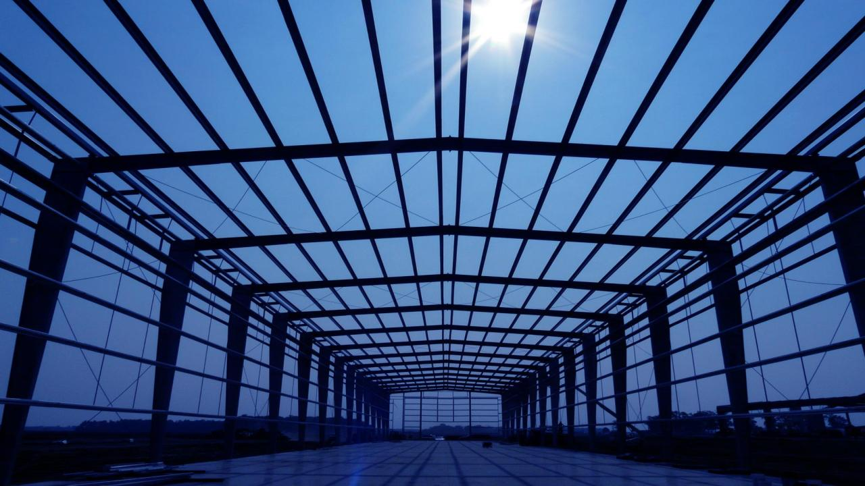
MEMBERSHIP
Experience the Benefits

Slide 2
IS YOUR BUSINESS READY?
American business is undergoing systemic, rapid and dramatic change.
At the Metal Building Manufacturers Association (MBMA), our focus is to serve the businesses within the metal building industry by providing powerful research and data to influence regulatory and code changes that can help or harm our members.
Metal Building Manufacturers Association

Slide 3
IS YOUR BUSINESS READY?
We are the ONLY association dedicated to engineering and technical issues, research, codes and standards, insurance and fire ratings, and enhancing the energy efficiency of the building envelope.
Together, we can grow market share, plan for the future, protect our industry and its position, and repel threats from changing market conditions.
Metal Building Manufacturers Association

Slide 4
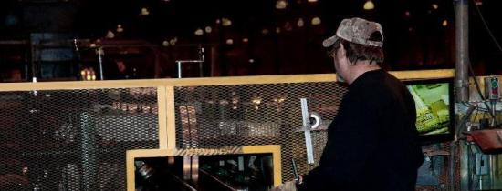
OUR MISSION
Our Mission
To enhance the collective interests of the metal building systems industry.
Our Pledge
To represent and promote the common interests of the member companies and wisely invest their resources to benefit the group.
Structure of MBMA
MBMA is comprised of:
Board of Directors consisting of individuals elected by the membership
Active Committees focused on growth for the industry
MBMA is administered by Thomas Associates, Inc. since its formation in 1956
Building Systems Members who sell, engineer and manufacture building systems
Associate Members who supply products and services to building systems members
Metal Building Manufacturers Association

Slide 5
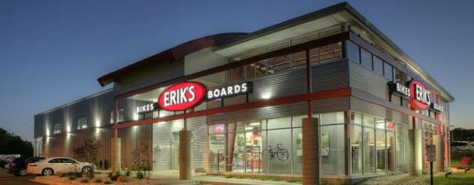
WHY JOIN MBMA?
“We actively support the MBMA and its efforts to maintain and enhance the industry image and reputation. Nucor strongly believes our continued support of MBMA and active involvement from all companies in the industry is essential to the overall health and growth of our industry for everyone’s benefit.”
-- Jeff Carmean, President
Nucor Building Systems
What is MBMA?
The Metal Building Manufacturers Association (MBMA) is comprised of industry leading companies who share a common goal of growing and improving the market for metal building systems.
As one person or even one firm, you cannot influence codes and legislation. Together, we can and do change processes and rulings. We save our members hundreds of thousands of dollars in time, labor, and business expenses.
Metal Building Manufacturers Association

Slide 6
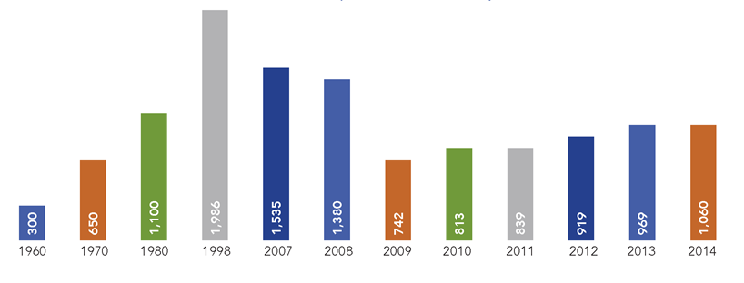
WHY JOIN MBMA?
A Classic Success
In its sixty-year history, MBMA’s proactive research and technical expertise have contributed to a growth rate in industry tonnage shipments from 300,000 tons in 1958 to almost 2,000,000 tons in 2014.
Tons of Steel Shipped, 1960-2014
(millions)
Metal Building Manufacturers Association

Slide 7
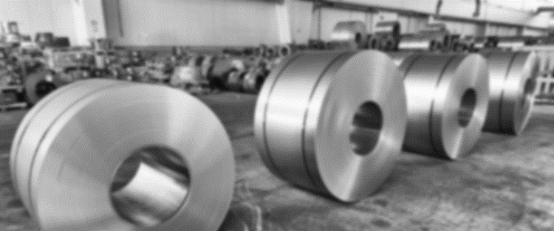
WHY JOIN MBMA?
MBMA Membership Give You Added Power in the Industry
Access to board meetings provides direct exposure to executives representing over 30 industry brands
Participation in committee activities
Preferred supplier status among building member companies
Advanced knowledge provided by MBMA provides ability to impact potential changes in codes and regulations
Email code alerts provide early notices of changes in codes and regulations
Historical and market statistical reports
Composite industry operating statistics concerning wage rates, productivity, safety, cost structure, etc…
Metal Building Manufacturers Association

Slide 8
WHY JOIN MBMA?
MBMA Protects and Grows the Industry
MBMA is the ONLY organization focused on communicating the benefits of our industry to influential government and regulatory bodies. Some of MBMA’s specific activities that enhance the industry’s growth are:
Technical Research and Lobbying – Targeted on building code, energy code and insurance code arenas, these efforts start with cutting-edge research.
Marketing the Industry – Our marketing efforts are focused on getting information to the public that represents the advantages our industry creates.
IAS AC472 Accreditation – The AC472 Accreditation Program is the most comprehensive quality assurance accreditation program of its kind. A unique characteristic of the AC472 Accreditation Program is that it audits the integrity of design engineering and manufacturing processes.
Metal Building Manufacturers Association

Slide 9
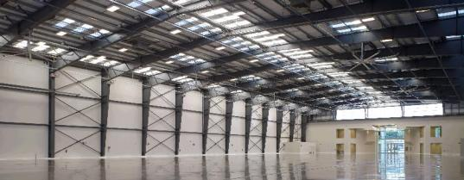
OUR ACHIEVEMENTS
First Choice
Metal building systems account for over 50% of the total low-rise nonresidential construction market.
What Have We Accomplished?
The Metal Building Manufacturers Association (MBMA) is leading the charge to make metal building systems a more accepted and respected building alternative.
Sponsored and/or authored over 200 technical research projects, resulting in code and regulatory changes. These reports directly influenced changes to the International Building Code (IBC), the American Society of Heating, Refrigerating and Air-Conditioning Engineers (ASHRAE), and the American Society of Civil Engineers (ASCE) standards, as well as impacting city, county, and state code regulations.
Metal Building Manufacturers Association

Slide 10
OUR ACHIEVEMENTS
Established metal building systems as a significant product in the non-residential construction market.
Established metal building systems using cold-formed steel technology as an acceptable building solution in the national and local building codes.
Overcame the insurance industry restrictions on metal buildings through education, testing, and developing a series of fire rated assemblies that resulted in more favorable metal building insurance rates.
Developed a Metal Building Systems Manual that contains the industry Common Industry Practices. These practices are very often a specified requirement for metal building projects.
Metal Building Manufacturers Association

Slide 11
OUR ACHIEVEMENTS
Motivated the steel industry to treat us as a distinct customer group, which resulted in the development of new steel specifications and grades.
Established the MBMA Technical Committee and appointed a Director of Research & Engineering who created sound criteria for testing the performance of structures under loads.
Maintain codes and standards activity that keeps the industry ahead of the competition through improved performance and reliability.
Established an Accreditation Program with the International Accreditation Service (IAS AC472) for the industry that assures performance, quality and efficiency of metal building systems manufacturers.
Metal Building Manufacturers Association

Slide 12
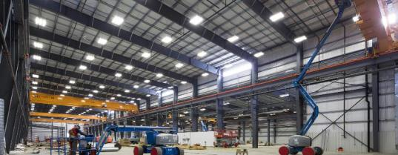
ACTIVE MEMBERSHIP
The Metal Building Manufacturers Association (MBMA) serves as the voice of the metal building systems industry, providing leadership, research, and education to increase the prominence and usage of metal building systems. MBMA plays a lead role in research and engineering, and influences codes and standards.
Committees
By becoming a member of MBMA, you can learn about MBMA's research and code activities, energy and sustainability advancements, insurance and safety programs. This work is achieved through nine operating committees which provide an excellent way to get involved.
Accreditation
Communications
Education
Energy
Insurance
Safety
Statistics
Sustainability
Technical
Metal Building Manufacturers Association

Slide 13
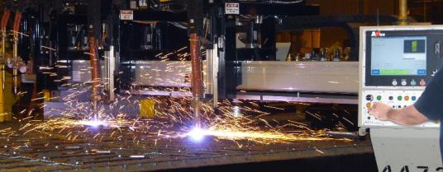
MARKETING & BENCHMARKING
The metal building systems industry is on the rise and MBMA is providing the knowledge, research, and leadership, to help it achieve more success and greater market share.
Marketing and Benchmarking Reports
MBMA has developed a comprehensive statistical program for our members. Associate members each receive, as a members-only benefit, copies of the compilations for the following statistics reports - which cannot be obtained anywhere else.
Square Footage Report (monthly)
Business Conditions Report (monthly)
End-Use Report (annual)
Roof & Wall Panel Report (annual)
County Shipment Report (quarterly)
Metal Building Manufacturers Association

Slide 14
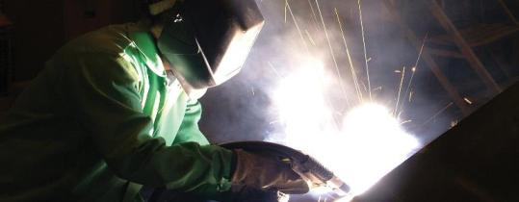
MEMBERSHIP
The MBMA Associate membership program was developed to serve the industry’s ancillary manufacturers and suppliers. Associate members help shape MBMA’s direction and activities through such affiliations as the Associate Member Advisory Council.
Eligibility
Associate Membership
Entities (except those eligible for Building Systems membership) which regularly supply raw materials, products or services to metal building systems members, or other categories as determined by the Board from time to time, shall be eligible to be MBMA Associate members.
Metal Building Manufacturers Association

Slide 15
MEMBERSHIP
Fees
The fee structure for Associate Members is as follows. Please contact MBMA for the most up-to-date fee schedule and descriptions.
Category I - Complimentary Membership for all AISI members in good standing who serve on the Construction Marketing Committee that co-funds MBMA projects.
Category II - More than $10 Million in annual sales - $16,154 per year
Category III - $6 Million to $10 Million - $10,769 per year
Category IV - $2 Million to $6 Million - $5,385 per year
Category V - Less than $2 Million - $2,693 per year
Category VI - Testing Laboratory, Accredited Inspection Agency, A/E Firm - $1,077 per year
Business Unit Category - $1,077 per unit (the corporate entity with the highest shipments to the industry is to hold the full Associate membership. All smaller entities within the corporate organization who wish to hold Associate membership in MBMA are eligible for Business Unit memberships.)
Metal Building Manufacturers Association

Slide 16
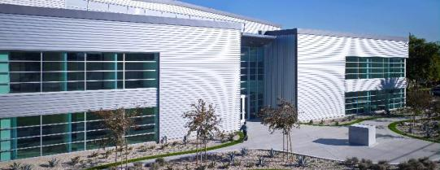
FREQUENTLY ASKED QUESTIONS
MBMA Membership Helps Position Companies for Success. By becoming a member of MBMA, you can learn about MBMA’s research and code activities, energy and sustainability advancements, insurance and safety programs.
FAQS
Why are Associate Members so important to MBMA? Not only do Associate Members supply needed financial support for industry projects, they also offer invaluable technical and business input which helps keep the industry ahead of the curve.
Are Associate Members allowed to participate in MBMA committee activities? Absolutely! Associate Members have the same rights to attend committee activities as the Building Systems members. In fact, everyone benefits as more perspectives go into any of the committee activities.
Metal Building Manufacturers Association

Slide 17
FREQUENTLY ASKED QUESTIONS
I noticed that Associate Members can supply either products or services. What kinds of services would qualify? Actually, we encourage membership for any service suppliers who might see MBMA’s Building Systems members as a primary customer base. Thus, companies who provide engineering software, architectural services, trucking services, environmental consulting, etc. could all be valid candidates for membership.
My component company sells products to MBMA Building Systems member companies but also fabricates an entire building system, am I qualified to be an Associate Member? Technically, yes, but our bylaws state that a company may not join as an Associate Member if it meets the requirements as a Building Systems member.
You state that Associate Members have preferred supplier status. Does this mean that Building Systems members will always buy from an Associate Member competing with a non-member? No, the law does not allow for that kind of exclusivity. All Associate Members must earn the business of the Building Systems members. However, the Building Systems members recognize the support that the Associate Members give to the MBMA and will welcome their supply proposals.
Are there any other advantages the Associate Members have in selling to the Building Systems members? Yes. Besides exposure to the key Building Systems executives at the semi-annual board meetings, the Associate Members receive a list of purchasing contacts for each company and purchasing people are supplied with Associate Member lists as well.
Metal Building Manufacturers Association

Slide 18
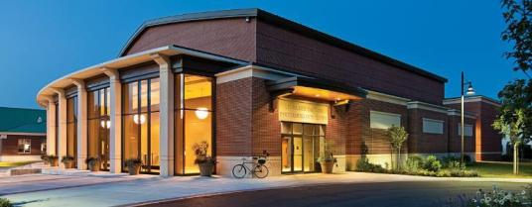
CONTACT
Metal building systems are far more sophisticated today than they were a decade ago. MBMA has invested heavily in engineering technology, fabrication concepts, structural improvements, and building quality. As a result, buildings today are far better in terms of cost, strength, function, and aesthetics.
To apply for membership contact MBMA for an application.
Join today.
Don’t get left behind.
Contact Information
Metal Building Manufacturers Association (MBMA)
1300 Sumner Avenue Cleveland, OH 44115-2851
Phone: (216) 241-7333
Fax: (216) 241-0105
Internet: www.mbma.com
Metal Building Manufacturers Association

